Slide 1
Demographic Landscapes: Spatial Analysis of U.S. Population Trends
Presented by Susheel Srikanth

Slide 2
Population Patterns: Unveiling Stories Through Data
In this presentation, we'll navigate through the U.S. Census data from 2000 to 2020, revealing how different counties and states have evolved demographically. Our journey will spotlight the diverse and dynamic nature of population changes across the nation
Which counties have transformed the most in terms of population growth and decline?
How do average and median populations across states reflect broader socio-economic trends?
This is an opportunity to see how data science can uncover interesting insights about the world around us
We will explore these questions through a series of data visualizations, each shedding light on a different aspect of the U.S. demographic landscape. Our analysis aims to provide a clear and insightful understanding of population trends over the past 20 years
Notes:
Opening Statement: "Imagine a country where some regions experience booming growth while others face significant decline. This is the story of the United States in the past two decades. Today, we'll uncover these hidden narratives through the lens of data."

Slide 3
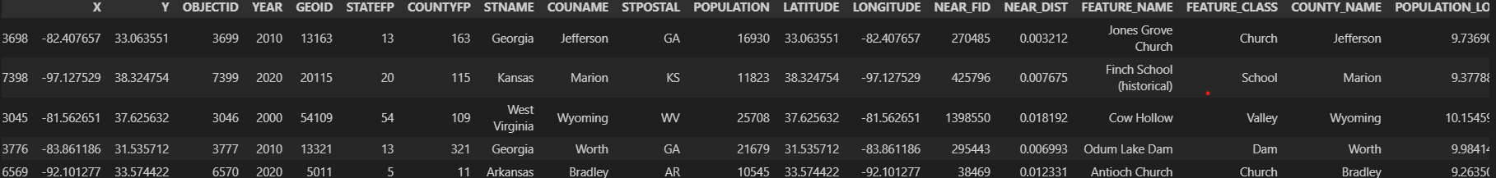
Dataset Overview
This analysis is based on a comprehensive dataset detailing population centers across U.S. counties.
Key Features of the Dataset:
-Time Frame: Data from 2000, 2010, and 2020
-Geographic Scope: Includes all U.S. counties
-Data Points: Population figures, geographic coordinates, and county identifiers
This dataset allows us to create visualizations that depict population distribution and identify trends in growth or decline across different counties over the past two decades.

Slide 4
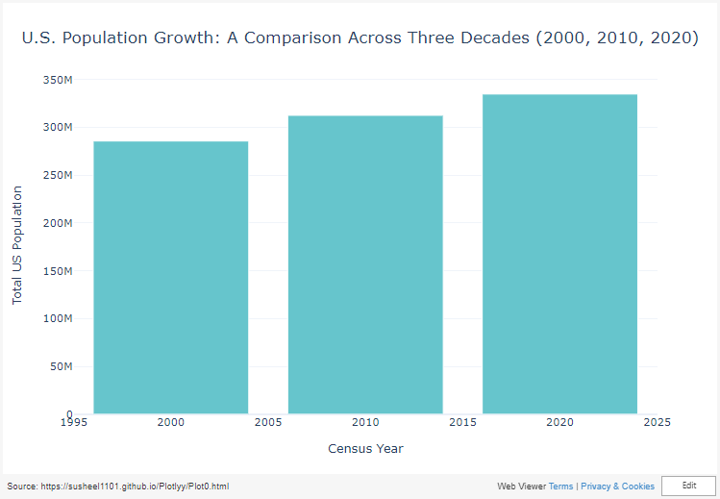
Key Takeaways:
Steady Growth:
The U.S. population increased consistently over the two decades, showcasing the country's ongoing demographic expansion.
Notable Increases:
From 2000 to 2010, the population grew by approximately 9.4%, reflecting a significant demographic surge in the early 21st century.
The growth continued from 2010 to 2020, albeit at a slightly slower pace of about 7.1%.
Notes:
Implications: These trends underscore the need for strategic planning in areas like urban development, healthcare, and education to accommodate the growing population.
Contextualization: The data points to broader societal shifts and presents an opportunity for policymakers to analyze and prepare for the future needs of an expanding populace.

Slide 5
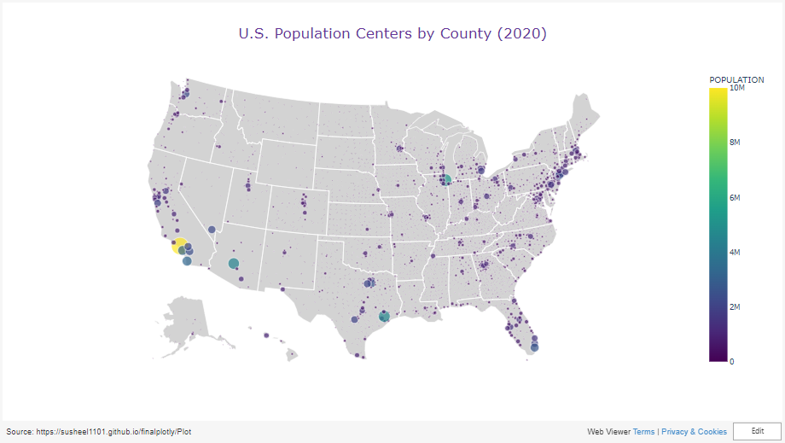
Notes:
Emphasize the geographic disparities in population distribution and how they relate to socio-economic factors.
Point out specific regions of high density as examples of urban hubs, and contrast them with less populated rural areas.
Highlight the utility of such visualizations in policy-making and resource management, especially in addressing challenges faced by both densely and sparsely populated areas.​
Geographical Distribution: The visualization highlights the geographic distribution of the U.S. population in 2020, with the size of each point corresponding to the population of a county.
Population Concentration: The map shows a clear concentration of population in specific regions, particularly along the East and West Coasts, as well as in some metropolitan areas in the interior.
Insight into Demographics: The map provides an intuitive understanding of how population is spread across the country, which is vital for understanding regional demographic trends.
Policy and Planning Implications: These spatial patterns are crucial for urban planning, resource allocation, and policy formulation, particularly in areas with high population densities.

Slide 6
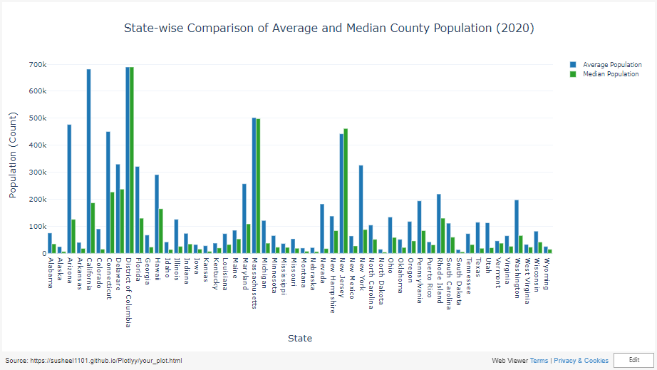
Notes:
Varied County Populations: In 2020, U.S. states displayed significant variations in average and median county populations, reflecting diverse demographic landscapes.
Skewness Indication: The discrepancy between average and median population sizes in some states suggests a skew in population distribution, often due to a mix of densely populated urban areas and sparser rural counties.
Urban-Rural Dynamics: States with larger gaps between average and median populations highlight the urban-rural divide, underscoring different demographic challenges and resource needs.
Insight for Policymaking: These trends provide essential insights for policymakers, indicating the necessity for state-specific strategies in urban development, infrastructure, and public services.

Slide 7
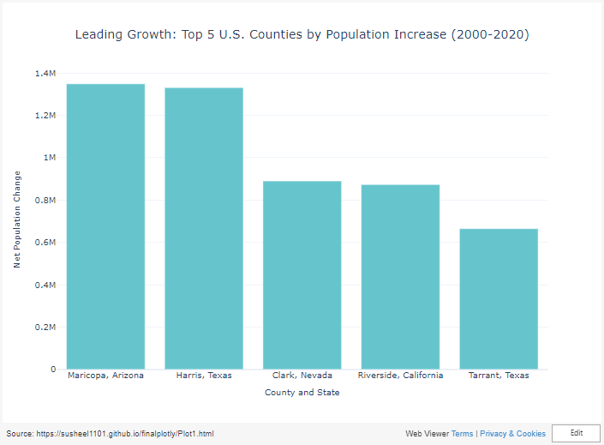
Key Takeaways:
Significant Growth: The top 5 counties experienced remarkable population growth from 2000 to 2020, showcasing areas of dynamic demographic change in the U.S.
Economic and Urban Attraction: This growth likely reflects economic prosperity, job opportunities, and urban appeal, drawing people to these regions.
Diverse Impact: The growth patterns in these counties may influence regional economies, housing markets, and social services, requiring adaptive and forward-looking policies
Notes:
Key Takeaways and Insights from the Matplotlib Bar Charts
Leading Growth: Top 5 U.S. Counties by Population Increase (2000-2020)
Remarkable Growth: The bar chart for the top 5 growing counties vividly illustrates substantial population increases over two decades. Each bar represents a county's net population change, with the green color symbolizing growth.
Diverse Geographical Representation: These counties may represent a diverse geographical spread, indicating growth trends that are not confined to a single region.
Economic and Social Implications: The significant population increase in these counties could be tied to economic opportunities, urban development, and migration patterns, impacting local infrastructure and services.

Slide 8
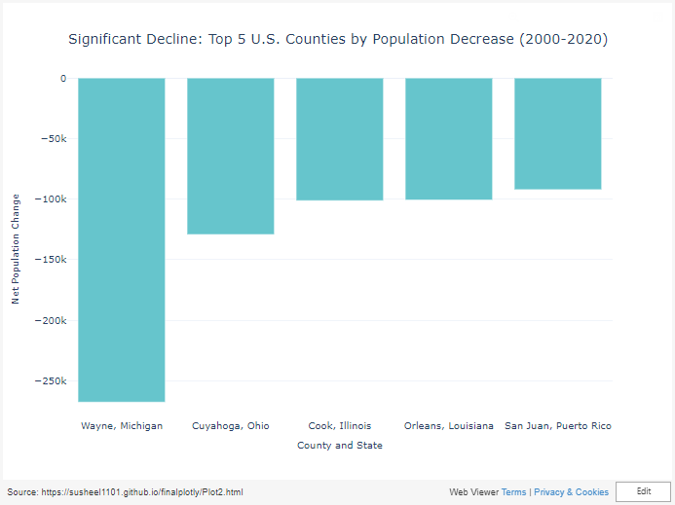
Key Takeaways:
Marked Decline: The featured counties have witnessed significant population decreases from 2000 to 2020, highlighting areas facing demographic challenges in the U.S.
Underlying Causes: These declines may be attributed to factors like economic downturns, limited job prospects, climate or environmental issues, which have influenced migration trends.
Policy Considerations: Addressing these declines requires targeted policy interventions, economic revitalization strategies, and community support to reverse or mitigate the negative impacts.
Notes:
Significant Decline: Top 5 U.S. Counties by Population Decrease (2000-2020)
Population Decline: The contrasting red bars represent counties with the most significant population declines, immediately drawing attention to areas facing demographic reduction.
Potential Challenges: These declining numbers could indicate challenges such as economic downturns, limited employment opportunities, or environmental factors driving people away.
Policy Implications: Understanding the causes and impacts of these declines is crucial for targeted policy interventions, economic revitalization, and community support initiatives.

Slide 9
Final Takeaway: Understanding U.S. Population Dynamics
Key Insights:
Steady Growth: The U.S. population has consistently grown, emphasizing the need for strategic urban planning and resource allocation.
Urban-Rural Contrast: A clear urban-rural divide in population distribution highlights different regional needs and challenges.
Regional Diversity: Variations in population changes across counties and states point to diverse economic and social landscapes.
Implications:
Policy Making: These trends are crucial for informed policymaking, particularly in urban development, economic planning, and infrastructure.
Future Outlook: Understanding these patterns helps anticipate future demographic shifts, guiding proactive and adaptive strategies.
Notes:
Closing Thoughts:
Data-Driven Decisions: This analysis underscores the importance of data-driven decision-making in addressing demographic changes.
Practical Relevance: For data science professionals, these insights offer a real-world application of data analysis in societal and policy contexts.

